Slide 1
Image Compression
邸慧军
ajon@bit.edu.cn
计算机学院
智能信息技术北京市重点实验室
图像计算与感知智能研究所

Slide 2
Content
Background and Motivation
Why Can We Compress?
Fidelity Criteria
The Flow of Image Compression
Reduce the Correlation between Pixels
Transform Coding
Predictive Coding
JPEG
Wavelet for Image Compression

Slide 3
Image Compression?
The problem of reducing the amount of data required to represent a digital image.
From a mathematical viewpoint: transforming a 2-D pixel array into a statistically uncorrelated data set.

Slide 4
Why do We Need Compression?
For data STORAGE and data TRANSMISSION
DVD
Remote Sensing
Video conference
FAX
Control of remotely piloted vehicle
The bit rate of uncompressed digital cinema data exceeds 1 Gbps

Slide 5
Information vs Data
REDUNDANTDATA
INFORMATION
DATA = INFORMATION + REDUNDANT DATA

Slide 6
Types of Compression
Lossy compression
discards redundant information, achieves higher compression ratios
digital image and video where some errors or loss can be tolerated
exploit both code and inter-pixel redundancy and sycho-visual perception properties
Lossless compression
can reconstruct the original image.
for legal and medical documents, computer programs
exploit only code and inter-pixel redundancy

Slide 7
Content
Background and Motivation
Why Can We Compress?
Fidelity Criteria
The Flow of Image Compression
Reduce the Correlation between Pixels
Transform Coding
Predictive Coding
JPEG
Wavelet for Image Compression

Slide 8
Why Can We Compress?
Basic data redundancies:
Coding redundancy
Inter-pixel redundancy
Psycho-visual redundancy

Slide 9
Coding Redundancy
Let us assume, that a discrete random variable r_{k} in the interval [0,1] represent the gray level of an image:
If the number of bits used to represent each value of r_{k} is l(r_{k}), then the average number of bits required to represent each pixel:
The total number bits required to code an MxN image:

Slide 10
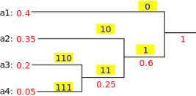
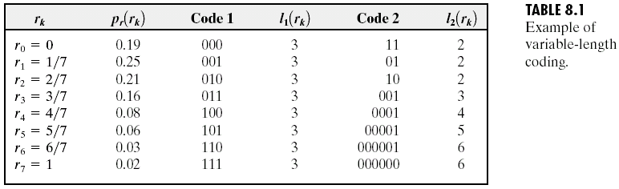
Coding Redundancy
Huffman Coding
Compression ratio:
Relative data redundancy:

Slide 11
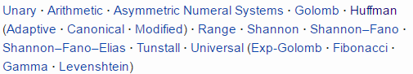
Other Entropy Encoding

Slide 12
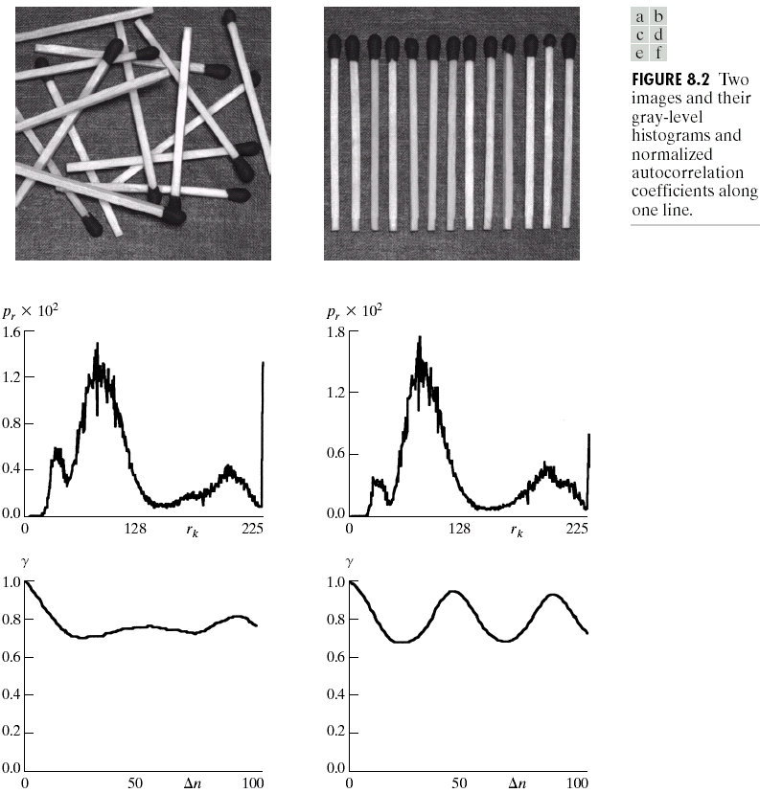
Inter-pixel Redundancy
Normalized Autocorrelation

Slide 13
Inter-pixel Redundancy Solution: Reduce the Correlation
Orthogonal Transform Coding
KLT (Karhunen-Loeve Transform)
Maximal Decorrelation Process
DCT (Discrete Cosine Transform)
JPEG is a DCT-based image compression standard, which is a lossy coding method and may result in some loss of details and unrecoverable distortion.
Subband Coding
DWT (Discrete Wavelet Transform)
To divide the spectrum of an image into the lowpass and the highpass components, DWT is a famous example.
JPEG 2000 is a 2-dimension DWT based image compression standard.
Predictive Coding
DPCM
To remove mutual redundancy between seccessive pixels and encode only the new information
Run Length Coding, LZW, …

Slide 14
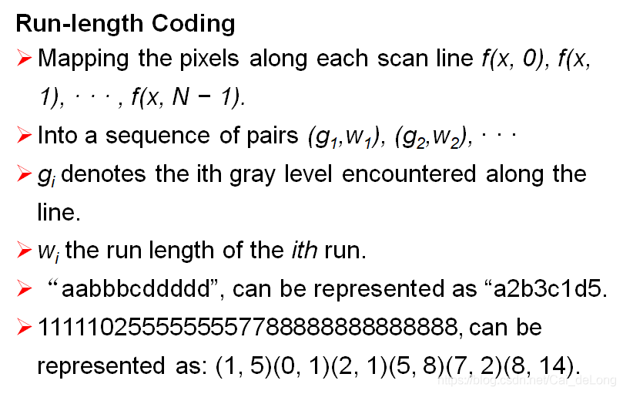
Run Length Coding

Slide 15
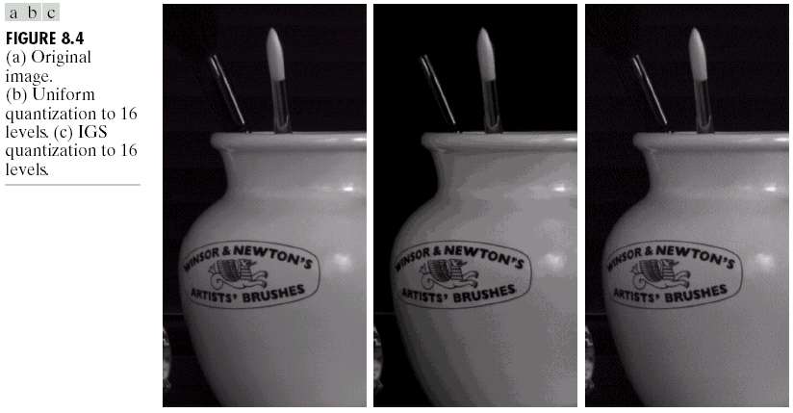
Psycho-visual Redundancy
IGS (improved gray-scale quantization)
Using break edges by adding to each pixel a pseudo-random number
Use heuristic techniques to compensate for the visual impact of quantization
Elimination of psych-visual redundant data results in a loss quantitative information
Improved Gray-Scale

Slide 16
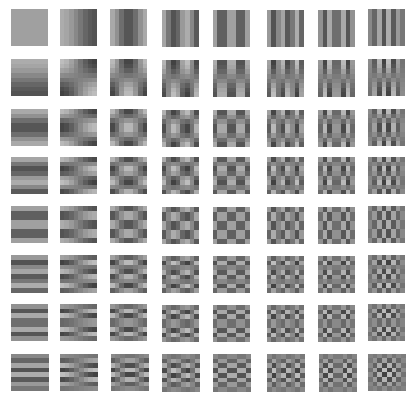
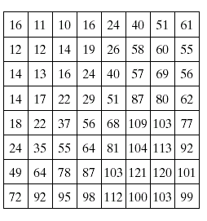
Psycho-visual Redundancy Solution: Quantization, Reduce Resolution
DCT Coefficient

Slide 17
Psycho-visual Redundancy Solution: Quantization, Reduce Resolution

Slide 18
YUV Color Space
In many applications, it is desirable to describe a color in terms of its luminance and chrominance content separately, to enable more efficient processing and transmission of color signals
One such coordinate is the YUV color space
Y is the components of luminance
Cb and Cr are the components of chrominance
The values in the YUV coordinate are related to the values in the RGB coordinate by

Slide 19
Spatial Sampling of Color Component
The three different chrominance downsampling format

Slide 20
Content
Background and Motivation
Why Can We Compress?
Fidelity Criteria
The Flow of Image Compression
Reduce the Correlation between Pixels
Transform Coding
Predictive Coding
JPEG
Wavelet for Image Compression

Slide 21
Fidelity Criteria
Objective fidelity:
Level of information loss can be expressed as a function of the original and the compressed and subsequently decompressed image.
Root-mean-square error
Mean-square signal-to-noise ratio
Peak signal to noise ratio

Slide 22
Fidelity Criteria

Slide 23
Fidelity Criteria
Rms errors: 5.17, 15.67, 14.17
Objective fidelity ranking: a, c, b

Slide 24
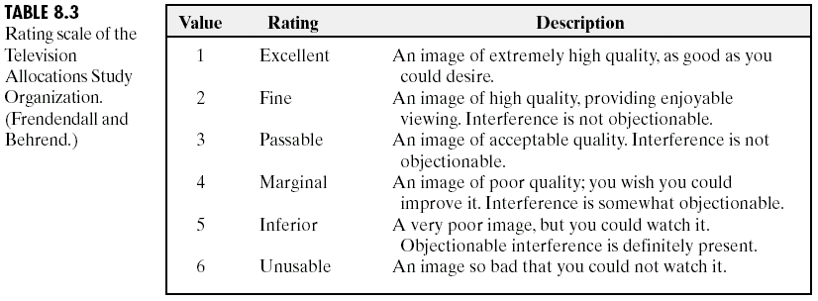
Fidelity Criteria
Subjective fidelity (Viewed by Human):
By absolute rating
By means of side-by-side comparison of and

Slide 25
Content
Background and Motivation
Why Can We Compress?
Fidelity Criteria
The Flow of Image Compression
Reduce the Correlation between Pixels
Transform Coding
Predictive Coding
JPEG
Wavelet for Image Compression

Slide 26
The Flow of Image Compression (1/2)
What is the so-called image compression coding?
To store the image into bit-stream as compact as possible and to display the decoded image in the monitor as exact as possible
Flow of compression
The image file is converted into a series of binary data, which is called the bit-stream
The decoder receives the encoded bit-stream and decodes it to reconstruct the image
The total data quantity of the bit-stream is less than the total data quantity of the original image

Slide 27
The Flow of Image Compression (2/2)
Compression Ratio:
Where n1 is the data rate of original image and n2 is that of the encoded bit-stream
The flow of encoding
Reduce the correlation between pixels
Quantization
Source Coding

Slide 28
Content
Background and Motivation
Why Can We Compress?
Fidelity Criteria
The Flow of Image Compression
Reduce the Correlation between Pixels
Transform Coding
Predictive Coding
JPEG
Wavelet for Image Compression

Slide 29
Reduce the Correlation between Pixels
Orthogonal Transform Coding
KLT (Karhunen-Loeve Transform)
Maximal Decorrelation Process
DCT (Discrete Cosine Transform)
JPEG is a DCT-based image compression standard, which is a lossy coding method and may result in some loss of details and unrecoverable distortion.
Subband Coding
DWT (Discrete Wavelet Transform)
To divide the spectrum of an image into the lowpass and the highpass components, DWT is a famous example.
JPEG 2000 is a 2-dimension DWT based image compression standard.
Predictive Coding
DPCM
To remove mutual redundancy between seccessive pixels and encode only the new information
Run Length Coding, LZW

Slide 30
Covariance
The covariance between two random variables X and Y, with expected value E[X]= and E[Y]= is defined as
If entries in the column vector X = [x₁,x₂,…,x_{N}]^{T} are random variables, each with finite variance, then the covariance matrix C is the matrix whose (i, j) entry is the covariance

Slide 31
Decorrelating Property of Transform
x₂
y₂
y₁
x₁
x₁ and x₂ are highly correlated
y₁ and y₂ are less correlated

Slide 32
Transform Coding (1/2)
Original sequence X=(x₀,x₁)
Transformed Sequence Y=(y₀,y₁)
Height | Weight
65 | 170
75 | 188
60 | 150
70 | 170
56 | 130
80 | 203
68 | 160
50 | 110
40 | 80
Height | Weight
181.97068384838812 | 3.416170333863853
202.40605916474945 | 0.887250469682385
161.55397378997284 | 0.559957738379552
183.8437168154677 | -1.219748938970085
141.51187032497342 | -3.223438711671541
206.13345984096256 | -2.999455616319722
173.822665082968 | -3.111447163995635
120.72055367314222 | -5.152467452589058
89.15897210197947 | -7.11882670939854
The original sequence tends to cluster around the line x₁=2.5x₀. We rotate the sequence by the transform :

Slide 33
Transform Coding (2/2)
Throw the value of weight y1
Inverse Transform
Height | Weight
181.97068384838812 | 0
202.40605916474945 | 0
161.55397378997284 | 0
183.8437168154677 | 0
141.51187032497342 | 0
206.13345984096256 | 0
173.822665082968 | 0
120.72055367314222 | 0
89.15897210197947 | 0
Height | Weight
68.16741797800859 | 168.72028006870275
75.82264431044632 | 187.66763012404562
60.51918377426525 | 149.79023613916877
68.86906847716196 | 170.45692599485025
53.01127967035257 | 131.20752139486424
77.21895318005868 | 191.12361585053173
65.11511642520563 | 161.165568622698
45.222715366778566 | 111.93014828010075
33.399538811586865 | 82.66675942272599
Height | Weight
65 | 170
75 | 188
60 | 150
70 | 170
56 | 130
80 | 203
68 | 160
50 | 110
40 | 80
Because the other element of the pair contained very little information, we could discard it without a significant effect on the fidelity of the reconstructed sequence

Slide 34
Discrete Cosine Transform (1/2)
Why DCT is more appropriate for image compression than DFT?
The DCT can concentrate the energy of the transformed signal in low frequency, whereas the DFT can not
For image compression, the DCT can reduce the blocking effect than the DFT
Forward DCT
Inverse DCT

Slide 35
Discrete Cosine Transform (2/2)
The 8-by-8 DCT basis
u
v

Slide 36
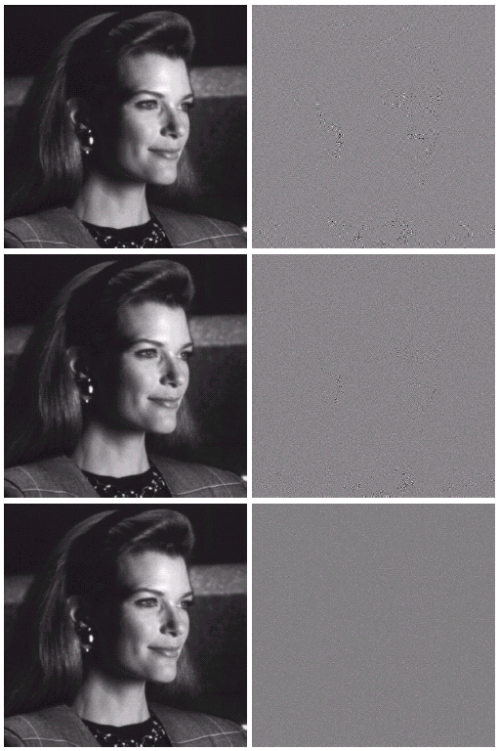
DCT
1. Dividing the image into sub-images of size 8x8
2. Representing each sub-image using one of the transforms
3. Truncating 50% of the resulting coefficients
4. Taking the inverse Transform of the truncated coefficients
DFT
rmse=1.28
DCT
rmse=0.68

Slide 37
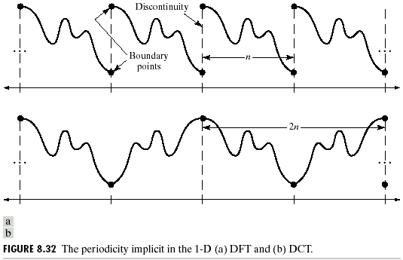
DCT
DCT Advantages:
1. Implemented in a single integrated circuit (IC)
2. Packing the most information into the fewest coefficients
3. Minimizing the block-like appearance (blocking artifact)

Slide 38
Content
Background and Motivation
Why Can We Compress?
Fidelity Criteria
The Flow of Image Compression
Reduce the Correlation between Pixels
Transform Coding
Predictive Coding
JPEG
Wavelet for Image Compression

Slide 39
Predictive Coding
- Encoding
x₁ x₂ … … x_{N}
y₁ y₂ … … y_{N}
y₁=x₁
y_{n}=x_{n}-x_{n-1}, n=2,…,N
- Decoding
y₁ y₂ … … y_{N}
x₁ x₂ … … x_{N}
x₁=y₁
x_{n}=y_{n}+x_{n-1}, n=2,…,N
x_{n}
_
y_{n}
y_{n}
x_{n}
+
x_{n-1}
x_{n-1}
x_{n}
D
+
D
x_{n-1}
Decoder
DPCM Loop
Encoder

Slide 40
Open-loop DPCM
y_{n}
^
^
x_{n}
_
y_{n}
x_{n}
Q
+
^
x_{n-1}
x_{n}
x_{n-1}
D
+
D
x_{n-1}
Decoder
Encoder
Notes:
• Prediction is based on the past unquantized sample
• Quantization is located outside the DPCM loop

Slide 41
Catastrophic Error Propagation with Open-loop DPCM
-1
0
error caused by quantization
original samples
90
92
91
93
93
95
…
b
a
prediction residues
90
3
0
3
0
3
a-b
a
decoded samples
90
93
93
96
96
99
…
b
a+b

Slide 42
Closed-loop DPCM
^
^
^
x_{n}
_
y_{n}
y_{n}
y_{n}
x_{n}
Q
+
^
^
^
x_{n-1}
x_{n-1}
x_{n}
D
+
D
^
x_{n-1}
Decoder
Encoder
X_{n},y_{n}: unquantized samples and prediction residues
^
^
X_{n},y_{n}: decoded samples and quantized prediction residues
Notes:
• Prediction is based on the past decoded sample
• Quantization is located inside the DPCM loop

Slide 43
Numerical Example
x_{n}
90
92
91
93
93
95
…
y_{n}
a
90
2
-2
3
0
2
a-b
Q
b
^
90
3
-3
3
0
3
y_{n}
a
b
a+b
x_{n}
^
90
93
90
93
93
96
…

Slide 44
Content
Background and Motivation
Why Can We Compress?
Fidelity Criteria
The Flow of Image Compression
Reduce the Correlation between Pixels
Transform Coding
Predictive Coding
JPEG
Wavelet for Image Compression

Slide 45
JPEG
The JPEG Encoder
The JPEG Decoder

Slide 46


JPEG Encoding
Original
JPEG 27:1

Slide 47
Differential Coding - JPEG (1/2)
Transform Coefficients
DC coefficient
AC coefficients
Because there is usually strong correlation between the DC coefficients of adjacent 8×8 blocks, the quantized DC coefficient is encoded as the difference from the DC term of the previous block
The other 63 entries are the AC components. They are treated separately from the DC coefficients in the entropy coding process
0 | 1 | 5 | 6 | 14 | 15 | 27 | 28
2 | 4 | 7 | 13 | 16 | 26 | 29 | 42
3 | 8 | 12 | 17 | 25 | 30 | 41 | 43
9 | 11 | 18 | 24 | 31 | 40 | 44 | 53
10 | 19 | 23 | 32 | 39 | 45 | 52 | 54
20 | 22 | 33 | 38 | 46 | 51 | 55 | 60
21 | 34 | 37 | 47 | 50 | 56 | 59 | 61
35 | 36 | 48 | 49 | 57 | 58 | 62 | 63
ZigZag Scan
[6]

Slide 48
Differential Coding - JPEG (2/2)
We set DC₀ = 0.
DC of the current block DC_{i} will be equal to DC_{i-1} + Diff_{i} .
Therefore, in the JPEG file, the first coefficient is actually the difference of DCs. Then the difference is encoded with Huffman coding algorithm together with the encoding of AC coefficients
Differential Coding :

Slide 49
Quantization in JPEG
Quantization is the step where we actually throw away data.
Luminance and Chrominance Quantization Table
lower numbers in the upper left direction
large numbers in the lower right direction
The performance is close to the optimal condition
Quantization
Dequantization

Slide 50
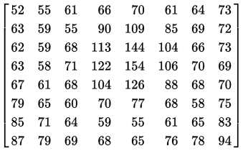
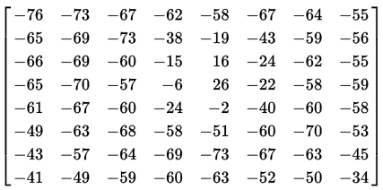
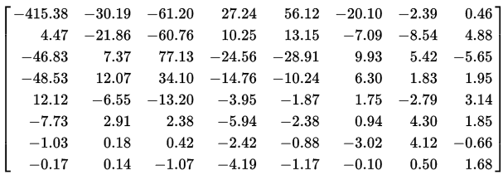
JPEG Encoding - Example
Sub-Image
-128
DCT
/Q

Slide 51
Content
Background and Motivation
Why Can We Compress?
Fidelity Criteria
The Flow of Image Compression
Reduce the Correlation between Pixels
Transform Coding
Predictive Coding
JPEG
Wavelet for Image Compression

Slide 52
DWT for Image Compression
Image Decomposition
Parent
Children
Descendants: corresponding coeff. at finer scales
Ancestors: corresponding coeff. at coarser scales
LL₃
HL₃
HL₂
LH₃
HH₃
HL₁
LH₂
HH₂
LH₁
HH₁
Parent-children dependencies of subbands: arrow points from the subband of parents to the subband of children.

Slide 53
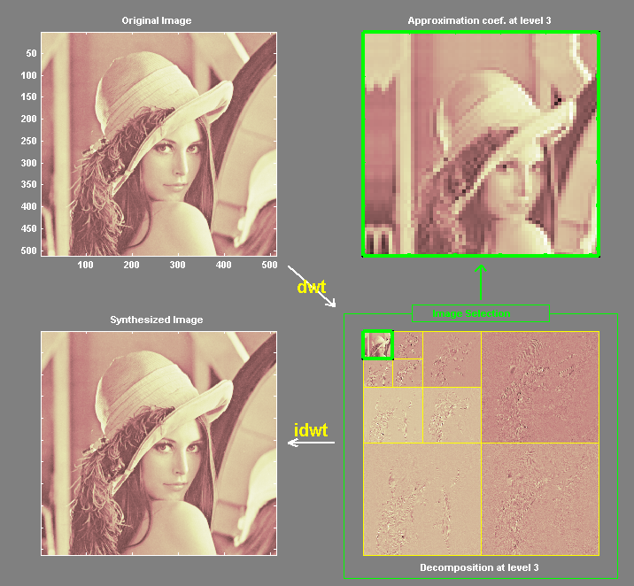
DWT for Image Compression
Image Decomposition
Feature 1:
Energy distribution concentrated in low frequencies
Feature 2:
Spatial self-similarity across subbands
LL₃
HL₃
LH₃
HH₃
HL₂
HL₁
LH₂
HH₂
LH₁
HH₁
The scanning order of the subbands for encoding the significance map.

Slide 54
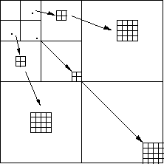
Embedded Zerotree Wavelet Compression (EZW)
The zerotree is based on the hypothesis that if a wavelet coefficient at a coarse scale is insignificant, then all wavelet coefficients of the same orientation in the same spatial location at finer scales are likely to be insignificant.
Natural images in general have a low pass spectrum. When an image is wavelet transformed, the energy in the sub-bands decreases with the scale goes higher so the wavelet coefficient will, on average, be smaller in the higher levels.

Slide 55
End

